Slide 1
Welcome to Camp Akela
At Mitigwa Scout Reservation
Notes:
Thank you, everyone, for coming tonight to learn more about Summer Camp 2025 for your Cub Scouts, Webelos, and Arrow of Light Scouts.

Slide 2
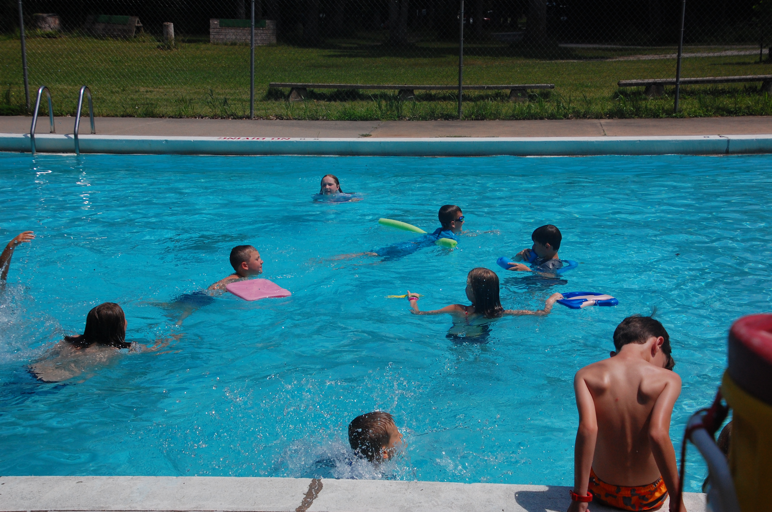
What is Camp Akela?
Camp Akela is a nationally accredited Cub Scout Camp and is a part of Mitigwa Scout Reservation.
It is just about 30 miles north-west of Des Moines, in Woodward, IA.
This is the perfect place for your Scout to fall in love with Scouting and the outdoors.
Notes:
For those of you that maybe unfamiliar with Mitigwa Scout Reservation, Camp Akela is the Cub Scout Camp at the reservation. It is located in Woodward, Iowa. Camp Akela is located on the original piece of land where Camp Mitigwa started on over 100 year ago. It became Camp Akela in 2008. Camp Akela hosts 5 weeks of summer camp for Cub Scouts in June and July. Our second season programming is from August to May. There are many opportunities for Cub Scout families to spend a day at camp at Cubs Fun Days, Haunted Harvest, and Winter Camp. Our Scouting pack, dens and families are also welcome to come to camp and use our facilities. Reservations can be made online. Always check in at the Deere Center when entering camp in our off season.

Slide 3
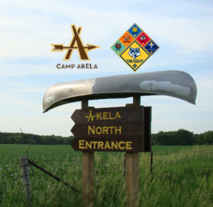
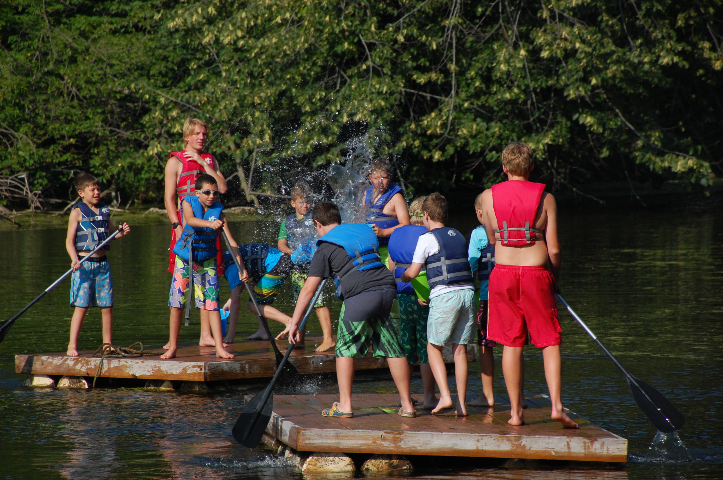
Summer Camp 2025
Water World
The iconic entrance to Camp Akela
Notes:
This summer our programming activities are being built around the theme Water World. Our world is full of all kinds of water, fresh water, salt water, ground water, rain….. We need water to stay alive, but it is also fun for recreation, sporting, and is a powerful agent of change in our environment. There is so much to learn about water! We will also have target activity areas, We Can Do It Village for Webelos and AOL and so much more!

Slide 4
A Camp that is right for everyone!
Scouts should attend camp based on the rank they will move up to in the spring of 2025 not the one they currently are.
 | Tiger | Wolf | Bear | Webels/AOL | Family Camp
Length | Day Camp 10 AM – 5 PM No overnight | 1.5 days 1 overnight | 2 days 1 overnight | 2.5 days 2 overnights | 2.5 days 2 overnights
Ranks | Tiger | Wolf | Bear | Webelos and Arrow of Light | All ranks and siblings accompanied by parents/gaurdians
Date | July 7, 8, 9 | June 14-15 June 16-17 July 1-2 | June 18-19 June 23-24 June 28-28 | June 20-22 June 25-27 July 3-5 | July 10-12

Slide 5
The price is right!
Scouts should attend camp based on the rank they will move up to in the spring of 2025 not the one they currently are.
 | Tiger Day Camp | Wolf Camp | Bear Camp | Webels/AOL Camp | Family Camp
Early Bird Price Jan 15-30 |  | Youth $90 | Youth $100 | Youth $140
Regular Price | Youth $50 Adult $20 | Youth $100 Adult $80 | Youth $110 Adult $90 | Youth $150 Adult $100 | Youth $150 Adult $125
Notes:
Early bird pricing is available for dens that sign up a minimum of 6 youth to attend camp together at the same session.

Slide 6
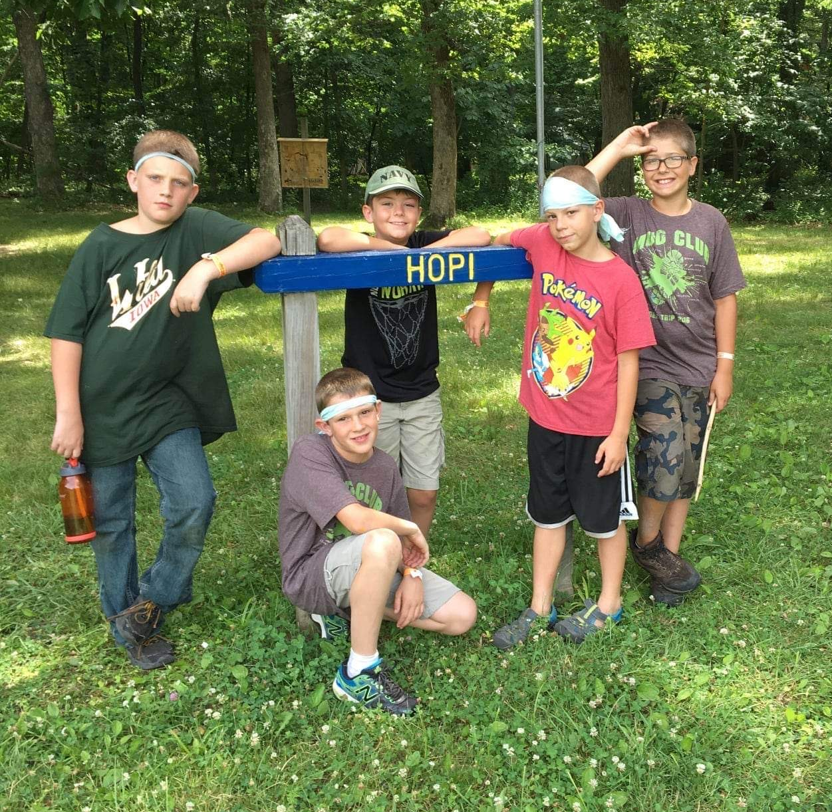
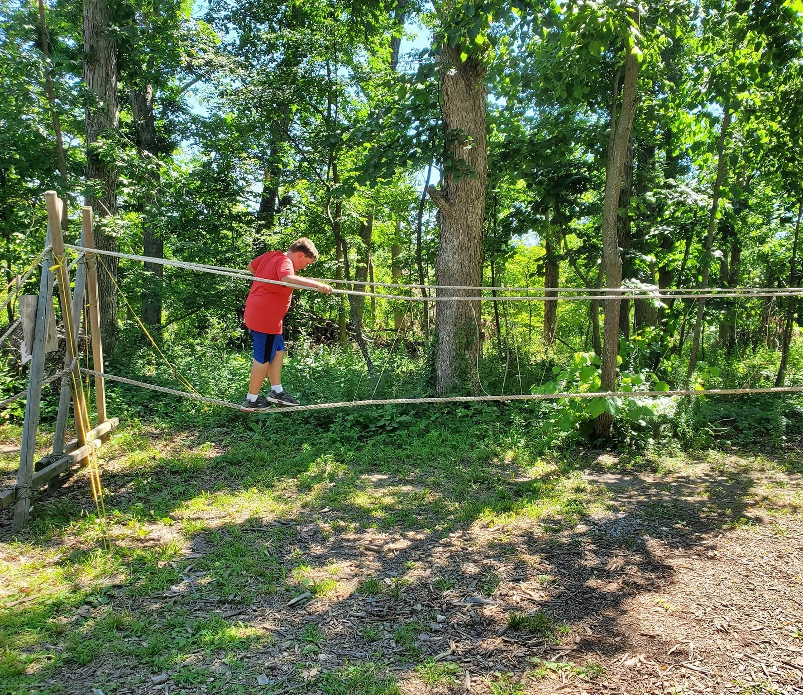
When you arrive at Camp Akela
Check in with your pack
All participants (youth and adults) will need to arrive at Camp with part A + B of the BSA health form completed
All adults must have an up-to-date copy of their youth protection certification upon arrival at Camp
Set up your campsite
Your unit will all be in the same campsite and share it with other Scouts! This will be your group for program rotations and meals - a great way for Scouts and leaders to make friends!
Explore Camp
Depending on when you arrive you might have some time before your first scheduled activity - feel free to explore Camp but be sure your Scouts stay in buddy pairs and adults are with them or know where they are going.
Notes:
Say: Sending your Scout to Camp, and coming to Camp yourself for the first time can be nerve wracking. The next few slides will walk us through what can be expected starting as soon as you arrive at Camp!
Check in with your pack: Camp Akela will send an email in the few weeks leading up to Camp to let us know what our packs check in time is. This time frame will be within the hour of the check in time listed on the last slide. Akela provides a packing list to go off of when preparing for Camp. Health forms A and B are required for both youth and adults staying at Camp. This health form does not require a doctor’s signature.
All adults must also have a copy of their youth protection online certification when checking into Camp
Set up you campsite: If you are attending the same Camp as other family’s from our pack you will be in the same Campsite. All campers sleep in tents.
This is also where details depend on the pack - this section of the presentation is a good time to tell them that they need to supply their own tent and/or camping supplies or if they can borrow the pack’s gear.
Explore Camp: When we’re at Akela, the pack leadership and adults are responsible for our Scouts at all times.
There may be time after setting up or downtime throughout Camp, Scouts are welcome to explore Camp as long as they stay in buddy pairs or are with an adult leader - 2 deep leadership should always be followed if it is not your child.

Slide 7
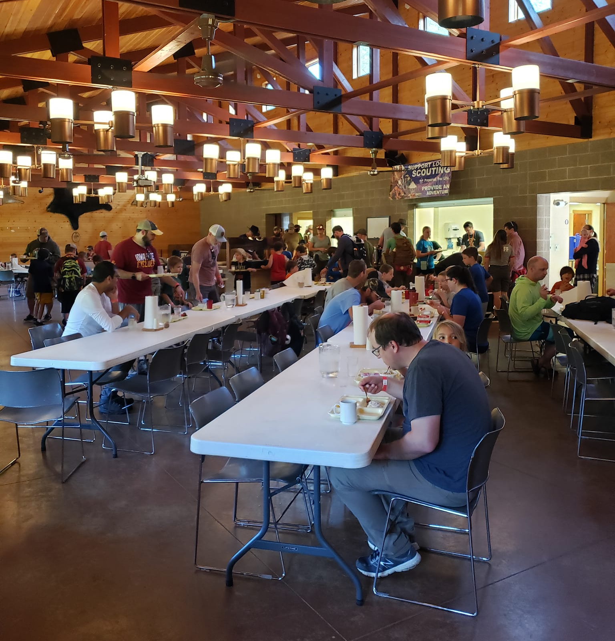
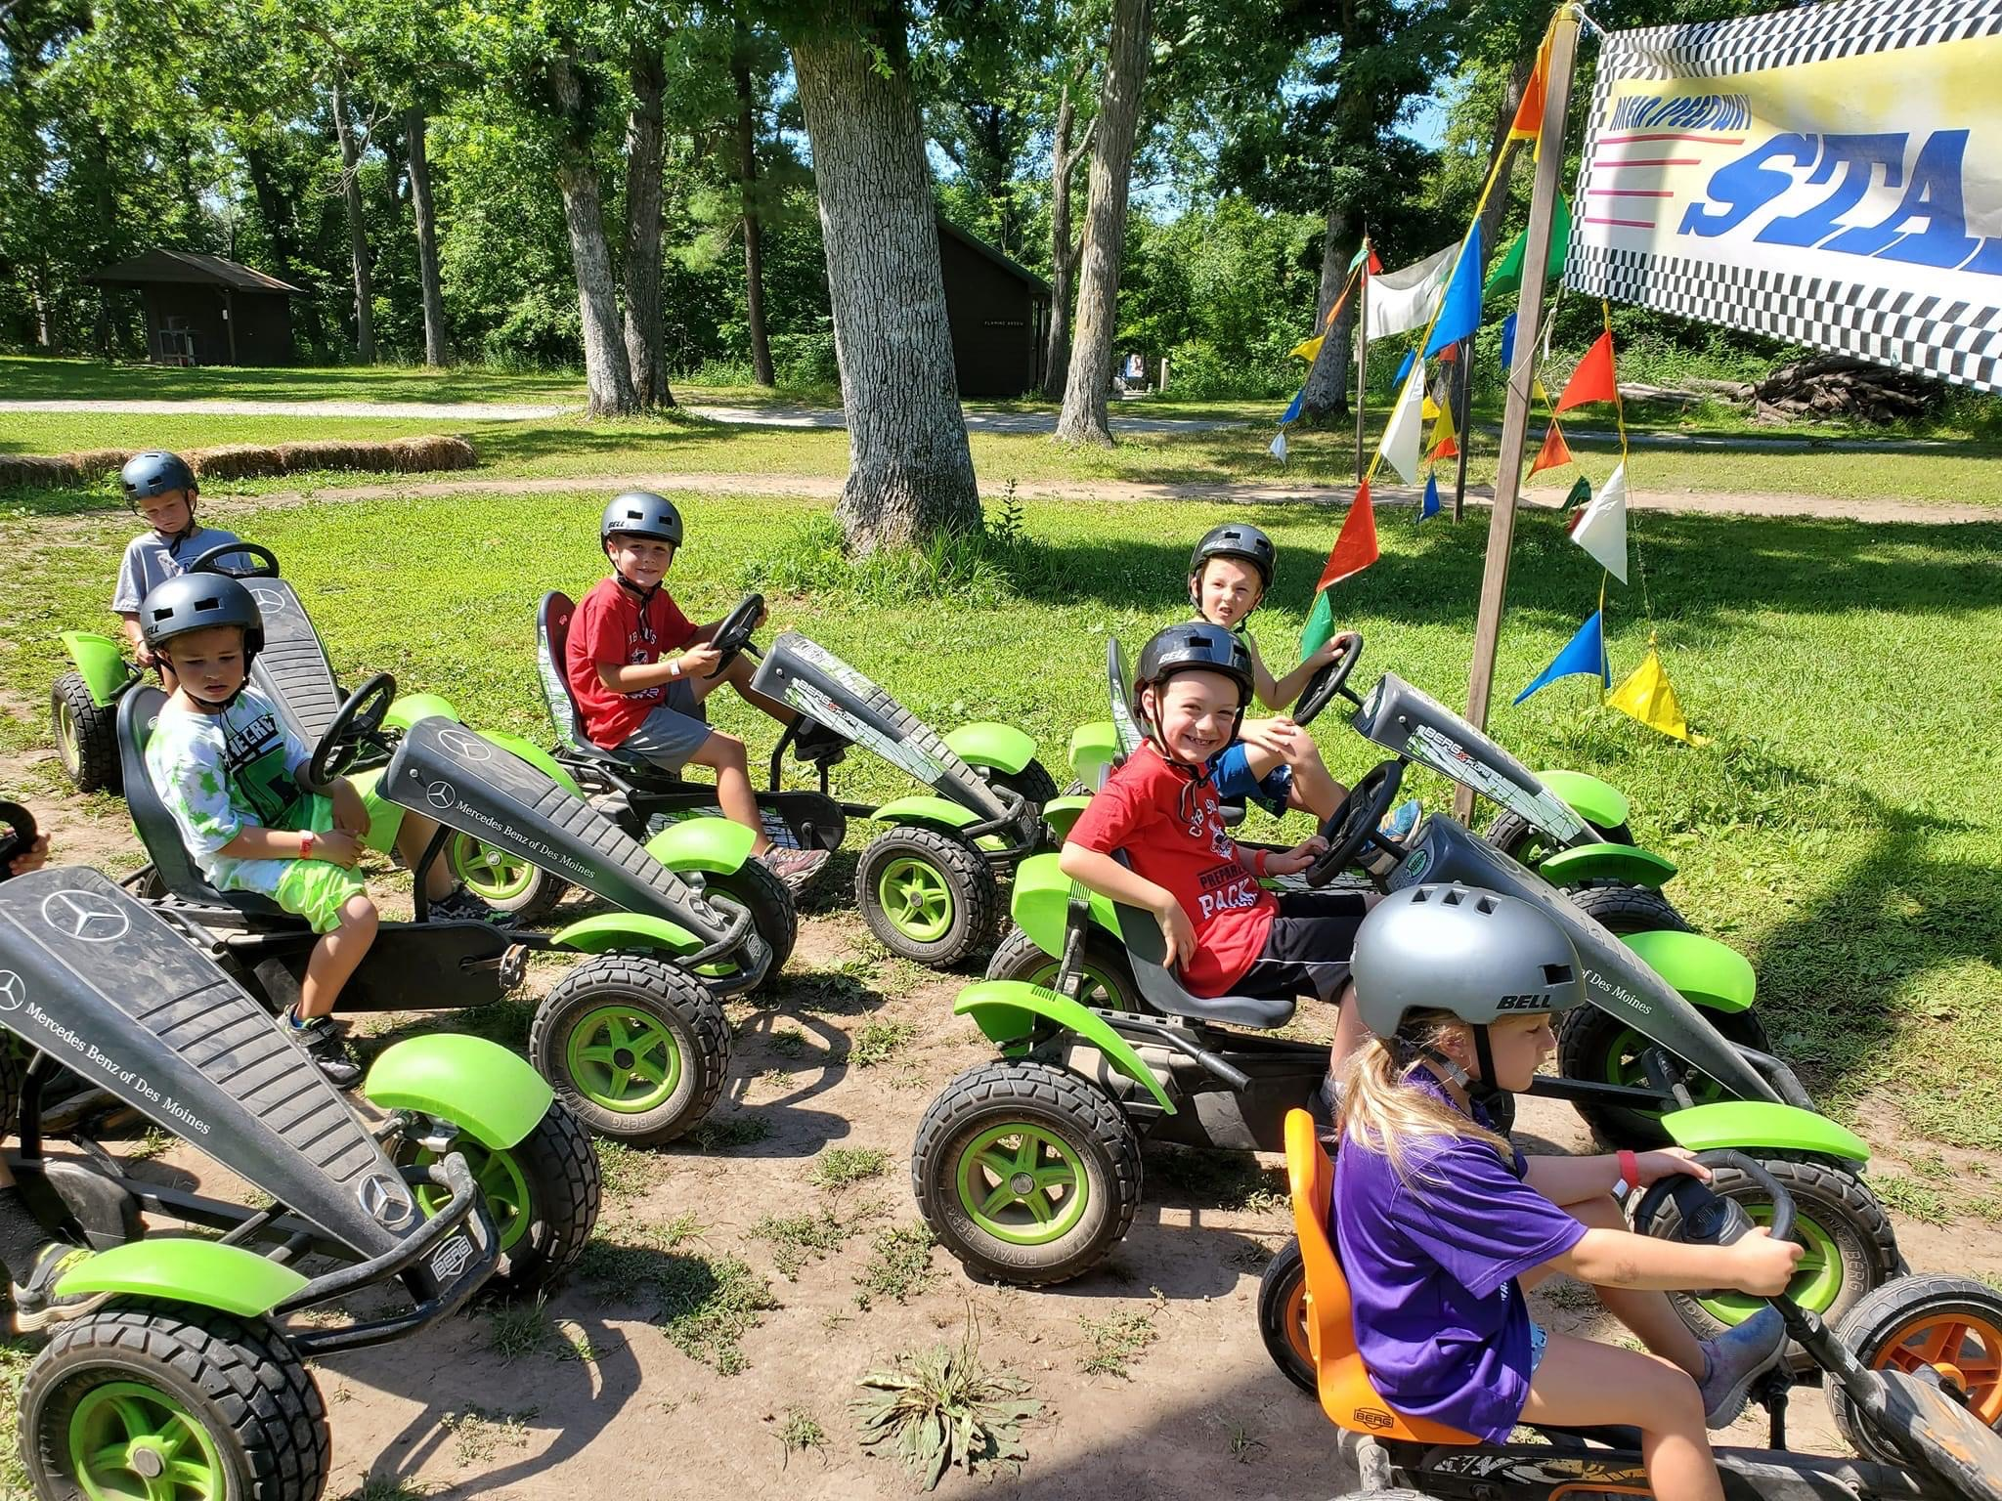
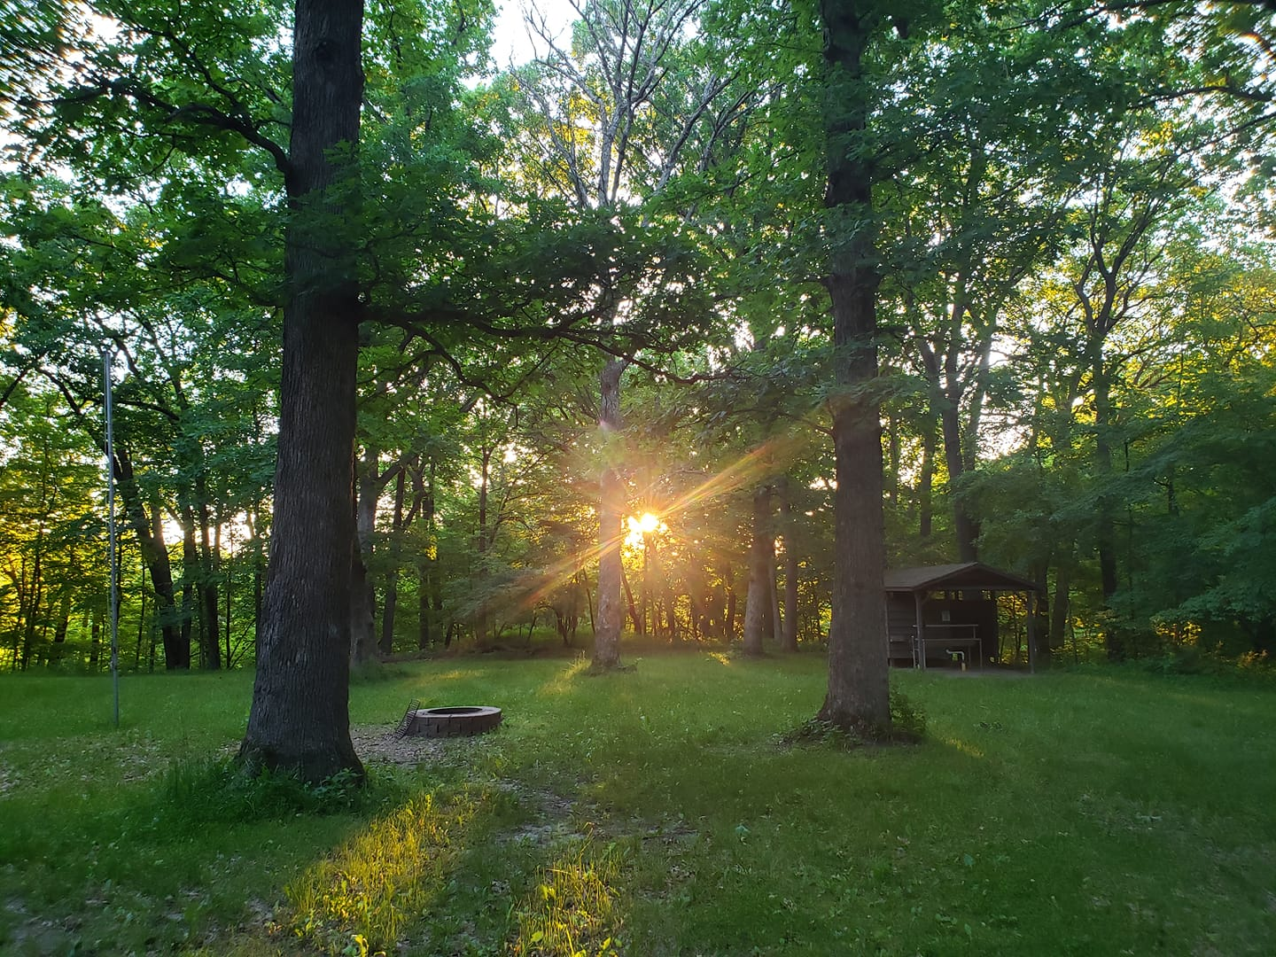
A day in the life at Camp Akela
Breakfast at Bear Creek
All meals will be served at Bear Creek cafeteria style.
All dietary restrictions should be marked on your registration and our online filled out for our kitchen staff. Reconfirm with our staff at check in.
Program Areas
You will receive a daily schedule and map during check in that will tell you what program areas to go to and when. Traveling as a group is recommended. More details will be shared when you arrive at Camp!
FIFO (Fluids In Fluids Out)
Camp Akela has latrines and porta potties throughout, with flushable toilets never too far away at Bear Creek and the Pool House.
Be sure to bring a reusable water bottle while at Camp! All water is safe to drink and the Camp conveniently places refill stations at program areas.
Notes:
Breakfast at Bear Creek: Camp Akela will serve all of our meals inside their dining hall; Bear Creek. If you or your Scout has dietary restrictions they should be recorded on their registration or emailed to the Camp before we arrive.
Program Areas: You can see listed on the handouts the programs Scouts will have the opportunity to do. An up to date schedule will be issued at check in to let you kno where your Campsite is scheduled to be and when.
FIFO (Fuilds In – Fluids Out): Camp Akela has latrines (pit toilets) throughout Camp AND flushable toilets on either side of the Camp that are never too far away. It is important for all campers to bring water bottles to stay hydrated during their stay at Camp. All water at Camp Akela is safe to drink

Slide 8
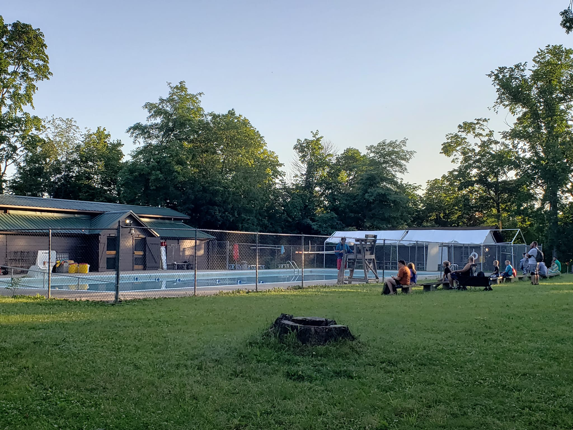
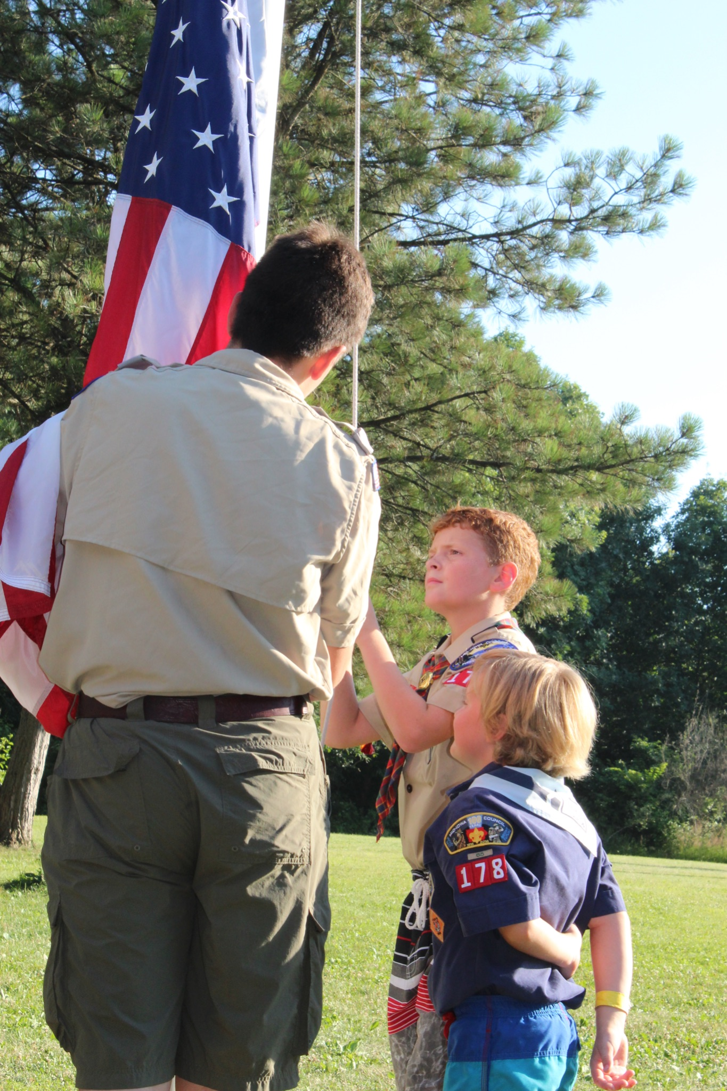
A day in the life at Camp Akela
Evening Programs
Depending on how long you’re at Camp the evening programs will vary.
Every Camp will get to watch and engage with songs and skits in the campfire show the staff puts on.
For the 1 night camps, you’re welcome to bring s’mores supplies for a campsite fire afterwards.
Shower Facilities
Adult shower facilities are located at Bear Creek.
Youth shower facilities are located at the pool house.
Dinner & Flags at Bear Creek
In the evenings we encourage Scouts to wear their uniform shirts for flags and dinner.
If your Scouts are interested they can even help with the flag ceremony!
Notes:
Dinner and Flags at Bear Creek: There is the opportunity to Scouts and leaders to wear their class A uniforms at flags. These uniforms are not required to be packed or worn.
Evening Programs: A day at Camp Akela is packed full of fun from sun up to sun down. After dinner Scouts will get to be entertained by a campfire show the staff put on and for the longer Camps will have the opportunity to visit their favorite areas for open areas.
Shower Facilities: Adult and youth have separate showers at Camp Akela. Scouts should be able to shower on their own when attending Camp.

Slide 9
Frequently asked Questions
Should I send my Scout to Camp with spending money?
YES! Camp registration should be paid in full before checking in and covers all costs and meals while at Camp. We do have a trading post that has ice cream, snacks, pocket knives, t-shirts and lots more that can be purchased while at Camp.
Where will we sleep?
All Campers should bring their own tents and sleeping gear. Scouts of the same gender and within 2 years of each other are allowed to be tent mates. Sleeping arrangements should be planned at the pack level.
What if I can’t attend Camp with my Scout?
The only Camp at Akela that requires every Scout to come with a parent is the Tiger Day Camp and Family Camp. The rest of the Camps follow BSA youth protection guidelines for the youth to adult ratios that are required.
Wolf and Bear Camp: 6 Cubs: 2 Adults Webelos: 8 Cubs: 2 Adults
Notes:
Trading post: Camp Akela has a trading post filled with camp trinkets, t-shirts, ice cream, pocket knives for purchase.
Tip! If your pack will be taking Scouts to camp without their parents, we recommend making sure there is a plan in place for the Scout or adults responsible for carrying the money and how it is to be spent. Some Scouts do GREAT at being responsible for their own money, but it depends on what works best for the adults at camp and the families.
Where will we sleep: Another great time to talk about what resources your pack or troop has available to borrow if that is a barrier to families attending Camp
What if I can’t attend Camp with my Scout? This is a time to discuss whether you have parents who are already signed up and to get an idea of how many Scouts might attend without a parent or other parents who are interested in attending. The more, the merrier!

Slide 10
Questions?

